Slide 1
Binary Trees
Chapter 6

Slide 2
Objectives
Trees, Binary Trees, and Binary Search Trees
Tree Traversal
Implementing Binary Trees
Binary Search Tree
Insertion
Deletion
Balancing a Tree
Simple tree balancing
The DSW Algorithm (*)
AVL Trees
Heaps
Polish Notation and Expression Trees (*)
Reading at home
Notes:
Note: (*) Means that students are required to understand essential features only (the problem explanation, definitions, the outline of algorithms…), not in details.

Slide 3
Deletion on Binary Search Trees
There are three cases of deleting a node from the binary search tree
The node is a leaf (it has no children)
The node has one child
The node has two children
Don't break the ordering property of the tree

Slide 4
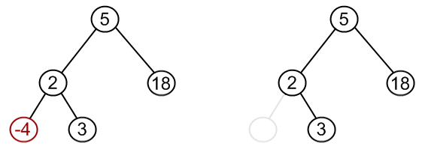
Deleting a leaf (node has no children)
node2.left = null

Slide 5
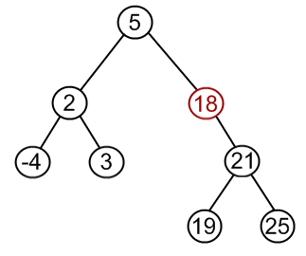
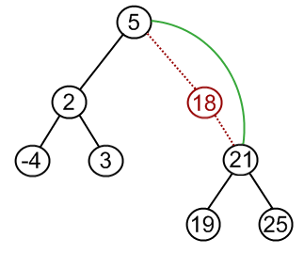
Deleting a node with one child
node18 = to be deleted
Node21 = only child of node18
node21.parent = node18.parent
node5.right = node21 if node18 = node5.right
node5.left = node21 if node18 = node5.left

Slide 6
For both of these cases
If the node doesn’t have left child
Point the node to its right child
We don’t care about the right child
If the node doesn’t have right child
Point the node to its left child
We don’t care about left child
Later on, point the parent (left or right) to the node
Left or right, depends on the node was left or right child of this parent

Slide 7
If the node doesn’t have a right child
Case: Doesn’t have right child
And the left child is not null
(It has one child)
Case: Doesn’t have right child
And the left child is null
(It is a leave)
prev
prev
7
7
p
p
node
3
9
node
3
9
8
null
null
null
We operate with both cases in the same way

Slide 8
If the node doesn’t have a left child
Case: Doesn’t have left child
And the right child is not null
(It has one child)
Case: Doesn’t have left child
And the right child is null
(It is a leave)
prev
prev
7
7
p
p
node
3
9
node
3
9
null
null
null
8
We operate with both cases in the same way

Slide 9
Deleting a node with two children
Delete by Merging
Delete by Copying

Slide 10
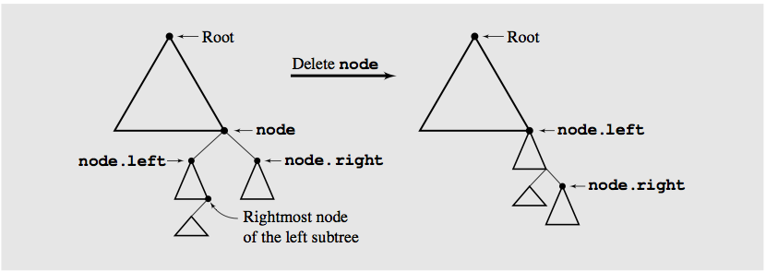
Delete by Merging
Making one tree out of the two substrees of the node
Now it has only one child (delete this using previous algo)
And then attaching it to the node’s parent substree is called deleting by merging

Slide 11
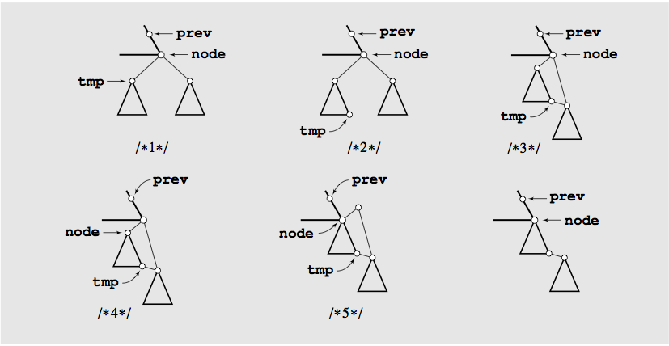
Delete by merging details

Slide 12
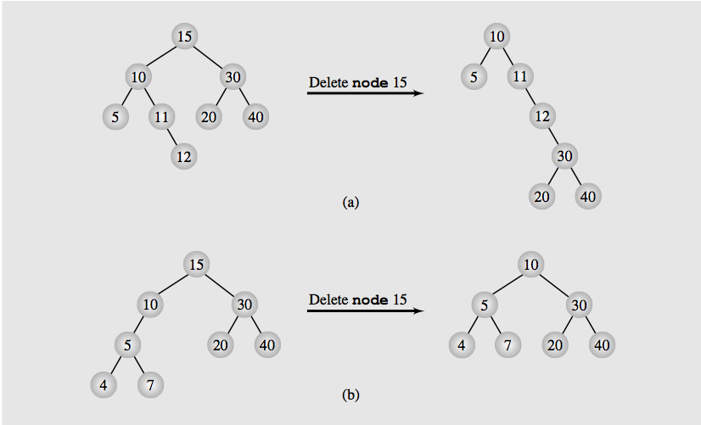
Height of a tree

Slide 13
Delete by Copying
If the node has two children, the problem can be reduced to
The node is a leaf
The node has only one nonempty child.
Solution: Replace the key being deleted with its immediate predecessor (or successor)
A key’s predecessor is the key in the right most node in the left substree

Slide 14
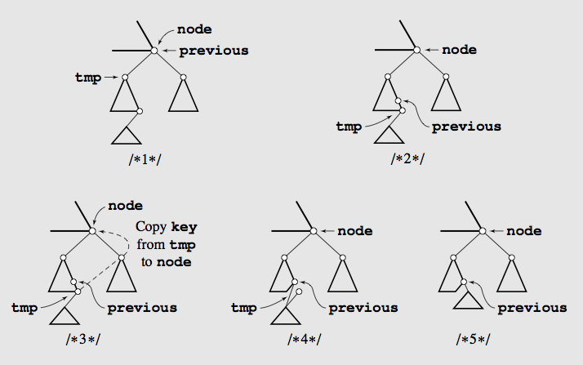
Delete by Copying

Slide 15
Delete cases
No child >> update parent pointer to null
Just one child >> link parent node to that child
Two children >> Merging method (taller tree)
Two children >> Copying method (shorter tree)

Slide 16
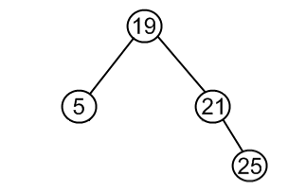
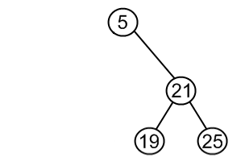
Details explanation
Same set of values may be represented as different binary-search trees.
Transforming the first into the second
Choose minimum element from the right subtree (19)
Replace 5 by 19
Hang 5 as left child

Slide 17
Details explanation
The same approach can be used to remove a node, which has two children
Find a minimum value on the right subtree (or the maximum on the left subtree)
Replace value of the node to be removed with found minimum. Now right subtree contains a duplicate
Apply remove to the right subtree to remove duplicate
Note also that the minimum node will not have left subchild
So the deletion is first/or second case (delete leaf, or delete node with one child) only.

Slide 18
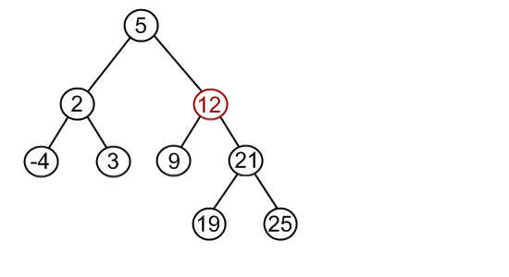
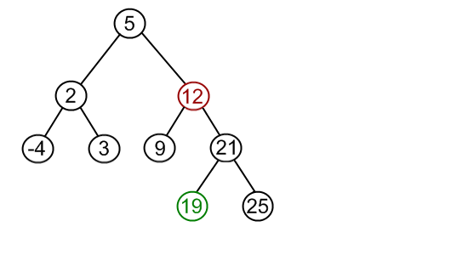
Delete by Copying

Slide 19
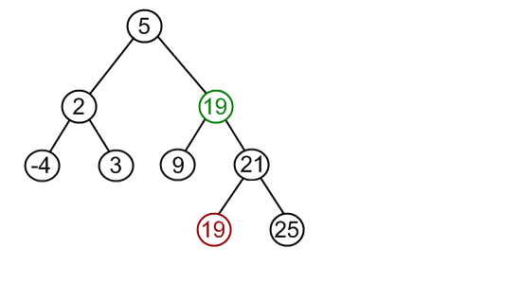
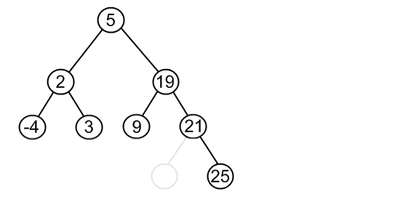
Delete by Copying

Slide 20
Example
prev
15
p
19
9
previous
node
17
18
4
12
tmp
3
null
13
Find the right most (largest) of the left subtree of the node, and its previous

Slide 21
Example
prev
15
p
19
4
previous
node
17
18
4
12
tmp
3
null
13
Find the right most (largest) of the left subtree of the node, and its previous
Copy the info of the largest node of this left subtree to the deleted node

Slide 22
Example
prev
15
p
19
4
previous
node
17
18
4
12
tmp
3
null
13
Find the right most (largest) of the left subtree of the node, and its previous
Copy the info of the largest node of this left subtree to the deleted node
If the left child’s right subtree is null (previous=node)
True: previous.left=temp.left;
False : Previous.left = temp.right

Slide 23
Example
prev
15
p
19
4
previous
node
17
18
12
3
13
Find the right most (largest) of the left subtree of the node, and its previous
Copy the info of the largest node of this left subtree to the deleted node
If the left child’s right subtree is null (previous=node)
True: previous.left=temp.left;
False : Previous.left = temp.right

Slide 24
Example
prev
15
p
19
9
previous
node
tmp
17
18
4
12
3
6
13
Find the right most (largest) of the left subtree of the node, and its previous
5
8
7

Slide 25
Example
prev
15
p
19
9
node
17
18
4
12
previous
3
6
13
tmp
Find the right most (largest) of the left subtree of the node, and its previous
5
8
7

Slide 26
Example
prev
15
p
19
8
node
17
18
4
12
previous
3
6
13
tmp
Find the right most (largest) of the left subtree of the node, and its previous
Copy the info of the largest node of this left subtree to the deleted node
5
8
7

Slide 27
Example
prev
15
p
19
8
node
17
18
4
12
previous
3
6
13
tmp
Find the right most (largest) of the left subtree of the node, and its previous
Copy the info of the largest node of this left subtree to the deleted node
If the left child’s right subtree is null
True: previous.left=temp.left;
False : Previous.right = temp.left
5
8
7

Slide 28
Example
prev
15
p
19
8
node
17
18
4
12
3
6
13
Find the right most (largest) of the left subtree of the node, and its previous
Copy the info of the largest node of this left subtree to the deleted node
If the left child’s right subtree is null
True: previous.right=temp.right;
False : Previous.right = temp.left
5
7

Slide 29
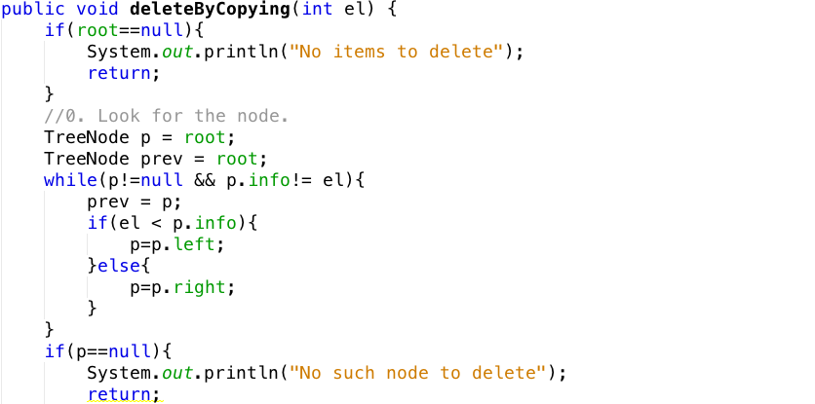
Find the node and its parent

Slide 30
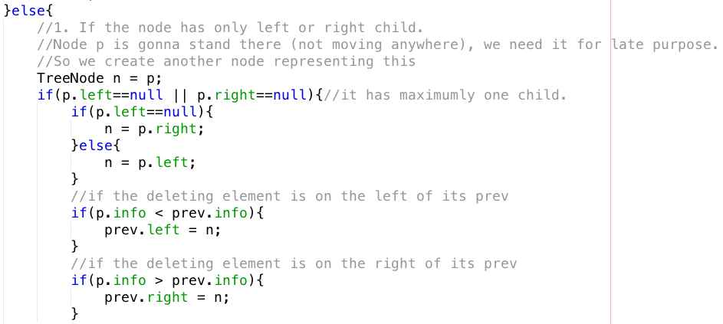
If the node is a leave or has one child

Slide 31
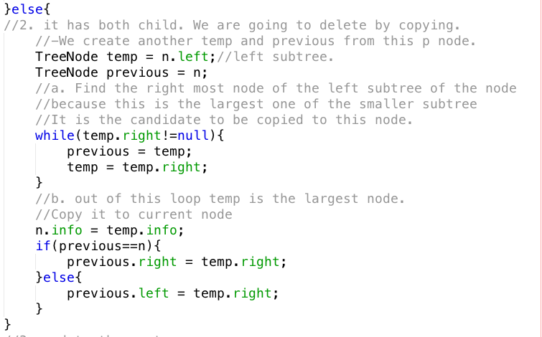
If the node has both children

Slide 32

Update root if deleting node is the root

Slide 33
Balancing Binary search trees

Slide 34
About balancing BST
What is a balanced tree in general?
No leaf is more than a certain amount farther from the root than any other
This is vague but, no matter the variation, a balanced tree should maintain the O(log n) invariant for most operations
Concrete definitions
Is height-balanced or balanced if the difference in height of both subtrees of any node in the tree is either zero or one
Is considered perfectly balanced if it is balanced and all leaves are to be found on one level or two levels

Slide 35
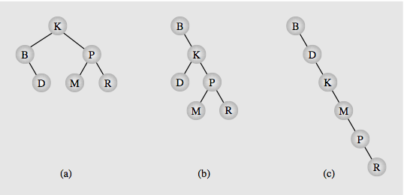
Why need to balance?
The best BST (shortest BST)
The worst BST

Slide 36
Simple balance algorithm
Copy all tree nodes to an array
Sort the array
Clear the tree
Call the balance() method
Insert the middle of the array
Recursively insert middle of the left part of the previous array
Recursively insert middle of the right part of the previous array segment

Slide 37
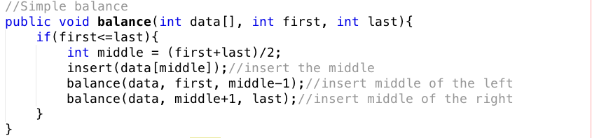
Simple balance algorithm Implementation

Slide 38
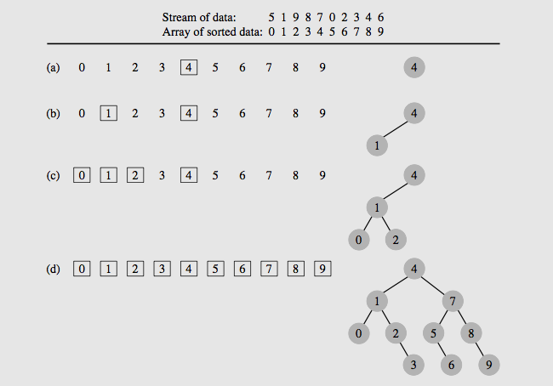
Example

Slide 39
DSW Balancing Algorithms
The simple balance algo’s issues
Requires an array to be sorted before balancing
Requires clear the old tree and build a new one every balancing is called
DSW: Day, Stout, Warren
Requires little additional intermediate variables and use no sorting algorithm
The building block for tree transformations is the rotation
There are two types of rotation, left and right, which are symmetrical to one another

Slide 40
Right rotation

Slide 41
Right rotation
Gr
Pr
Ch
R
P
Q

Slide 42
Right rotation
Gr
Pr
Ch
R
P
Q

Slide 43
Right rotation
Gr
Pr
Ch
P
Q
R

Slide 44
Right rotation
Gr
Ch
Pr
P
Q
R

Slide 45
Right rotation
- Ch has 3 children
- Q: Right child of Ch must be smaller than Pr
- Q: must be larger than Ch (right child of Ch)
- Q: is qualified to be left child of Pr
Gr
Ch
Pr
P
Q
R

Slide 46
Right rotation
Gr
Ch
Pr
P
Q
R

Slide 47
Right rotation
Gr
Ch
Pr
P
Q
R

Slide 48
Right rotation
Gr
Ch
Pr
P
R
Q

Slide 49
Right rotation
Gr
Ch
Pr
P
R
Q

Slide 50
x2 = x1.left
r2 = x2.right
x1.left = r2
x2
x1
x1
P
x2
r1
r1
r2
P
r2
x1.left = r2
x2
x1
x2.parent = x1.parent
X2.parent.child=x2
X1.parent = x2
P
r1
r2

Slide 51
Left rotation

Slide 52
Left rotation
Gr
Ch
Pr
P
R
Q

Slide 53
Left rotation
Gr
Q: is qualified to be right child of Ch.
Q > Ch
Q < Pr
Ch
Pr
P
R
Q

Slide 54
Left rotation
Gr
Ch
Pr
P
Q
R

Slide 55
Left rotation
Gr
Ch
Pr
P
Q
R

Slide 56
Left rotation
Gr
Ch
Pr
P
Q
R

Slide 57
Left rotation
Gr
Ch
Pr
P
Q
R

Slide 58
Left rotation
Gr
Pr
Ch
P
Q
R

Slide 59
Left rotation
Gr
Pr
Ch
R
P
Q

Slide 60
Left rotation
Gr
Pr
Ch
R
P
Q

Slide 61
x1
x2
x1
x2
l1
l1
l2
R
R
l2
x1.right = l2
l2.parent = x1
x2.parent = x1.parent
x2.parent.child = x2
(child = left or right)
x2 = x1.right
l2 = x2.left
x2
x1.parent = x2
x2.left = x1
x1
R
l1
l2

Slide 62
Left rotation
Left rotation is the reverse of right rotation.

Slide 63
DSW Algo
DSW consists of two steps
1. Transform tree into link list like tree (backbone or vine)
2. Rotating every second node of the backbone about its parent

Slide 64
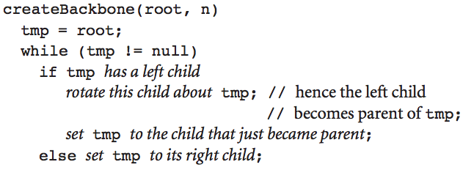
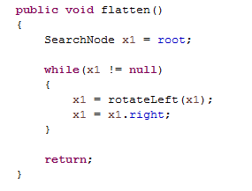
Step 1. Creating the backbone

Slide 65
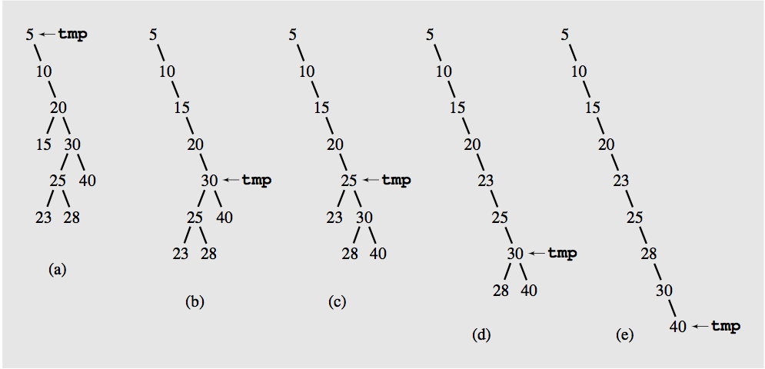
Step 1. Creating the backbone

Slide 66
20
30
25
20
40
20
20
23
28
30
30
25
40
25
25
30
40
23
28
23
28
23
40
28

Slide 67
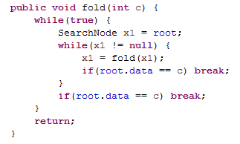
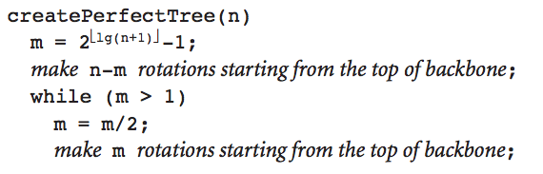
Step 2. Building perfectly balanced tree
Every second node down to certain point is rotated about its parent
The first pass may not reach the end of the backbone:
It’s used to account for the difference between the number n of nodes in the current tree and the number 2 powers of upper round of lg(n+1) then – 1

Slide 68
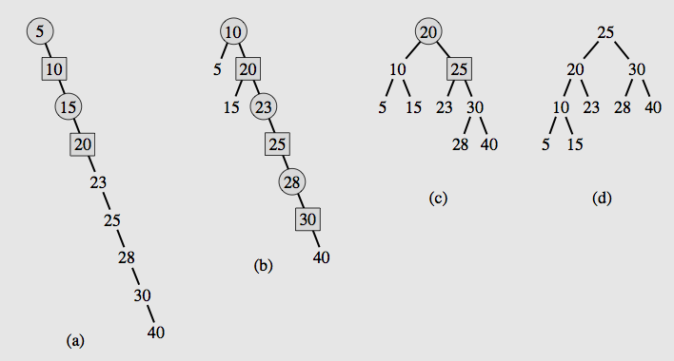
Step 2. Building perfectly balanced tree
At node5, we rotate so that node10 as parent, and 5 will be left child of 10
At node 15, we make 20 the parent, and 15 will be left child of 20

Slide 69
Henry: more tests
1 2 3
1 2 3 4 5 6 7
1 2 3 4 5 6 7 8 9
1 2 3 4
1 2 3 4 5

Slide 70
Objectives
Trees, Binary Trees, and Binary Search Trees
Tree Traversal
Implementing Binary Trees
Binary Search Tree
Insertion
Deletion
Balancing a Tree
The DSW Algorithm (*)
AVL Trees
Heaps
Polish Notation and Expression Trees (*)
Reading at home
Notes:
Note: (*) Means that students are required to understand essential features only (the problem explanation, definitions, the outline of algorithms…), not in details.

Slide 71
Tổ chức chương trình
Có các hàm căn bản >> biến thành chương trình
Có yêu cầu của khách >> biến thành hệ thống
Module khách hàng
Đọc danh sách khách
Testing units
Module đơn hàng
Ghi danh sách khách
Main frame
Tìm kiếm khách hang
Module sản phẩm

